Slide 1
Education Session at Melbourne Zoo

Slide 2
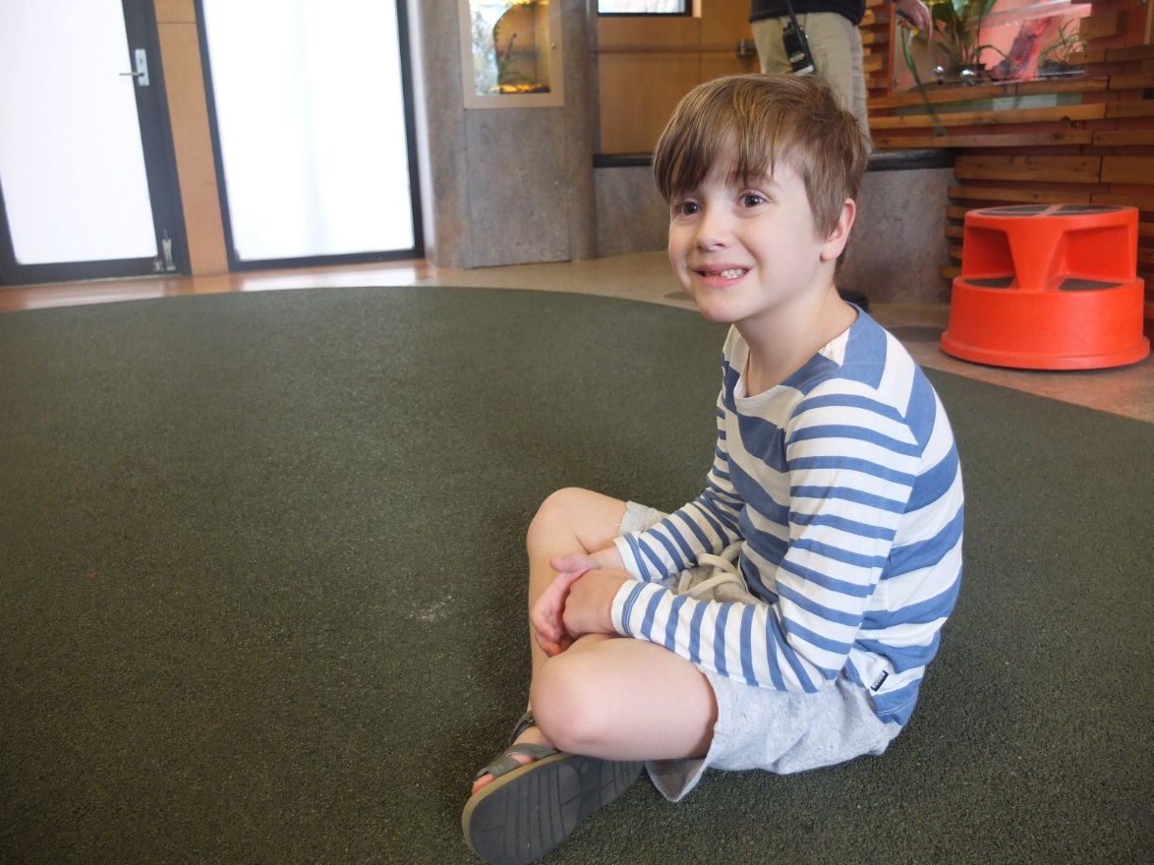
My class might go into a special area and someone from the zoo can talk to us.
While it looks different, this is similar to the classroom at school.
I could try to remember to behave like I do at school.

Slide 3
Our class might have the chance to meet a special animal during our visit.
The animal will not hurt me.
Notes:
Touching an animal

Slide 4
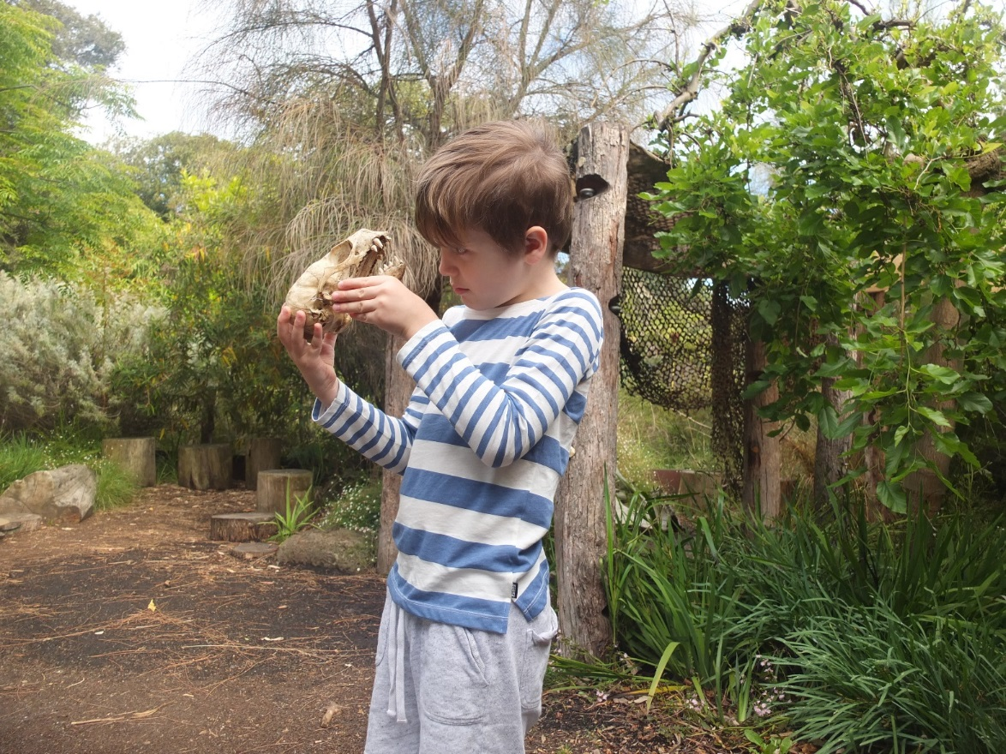
I might also get to touch some special things.
If someone else from my class is holding something I could try to just look at it.
If I do get to hold something I can try to be careful.
Notes:
Looking at BioFacts

Slide 5
Extras Melbourne Zoo

Slide 6
When I visit Melbourne Zoo I can try to remember:
To listen to the adult who is leading my group
Stay close to my group
Walk and not run
Speak with my quiet voice, even though it may be noisy
Only touch things I am told that I am allowed to
Be quiet around the animals
Not tap on any glass

