Slide 1
Autism Friendly Werribee Open Range Zoo Social Scripts for School Updated October 2019

Slide 2
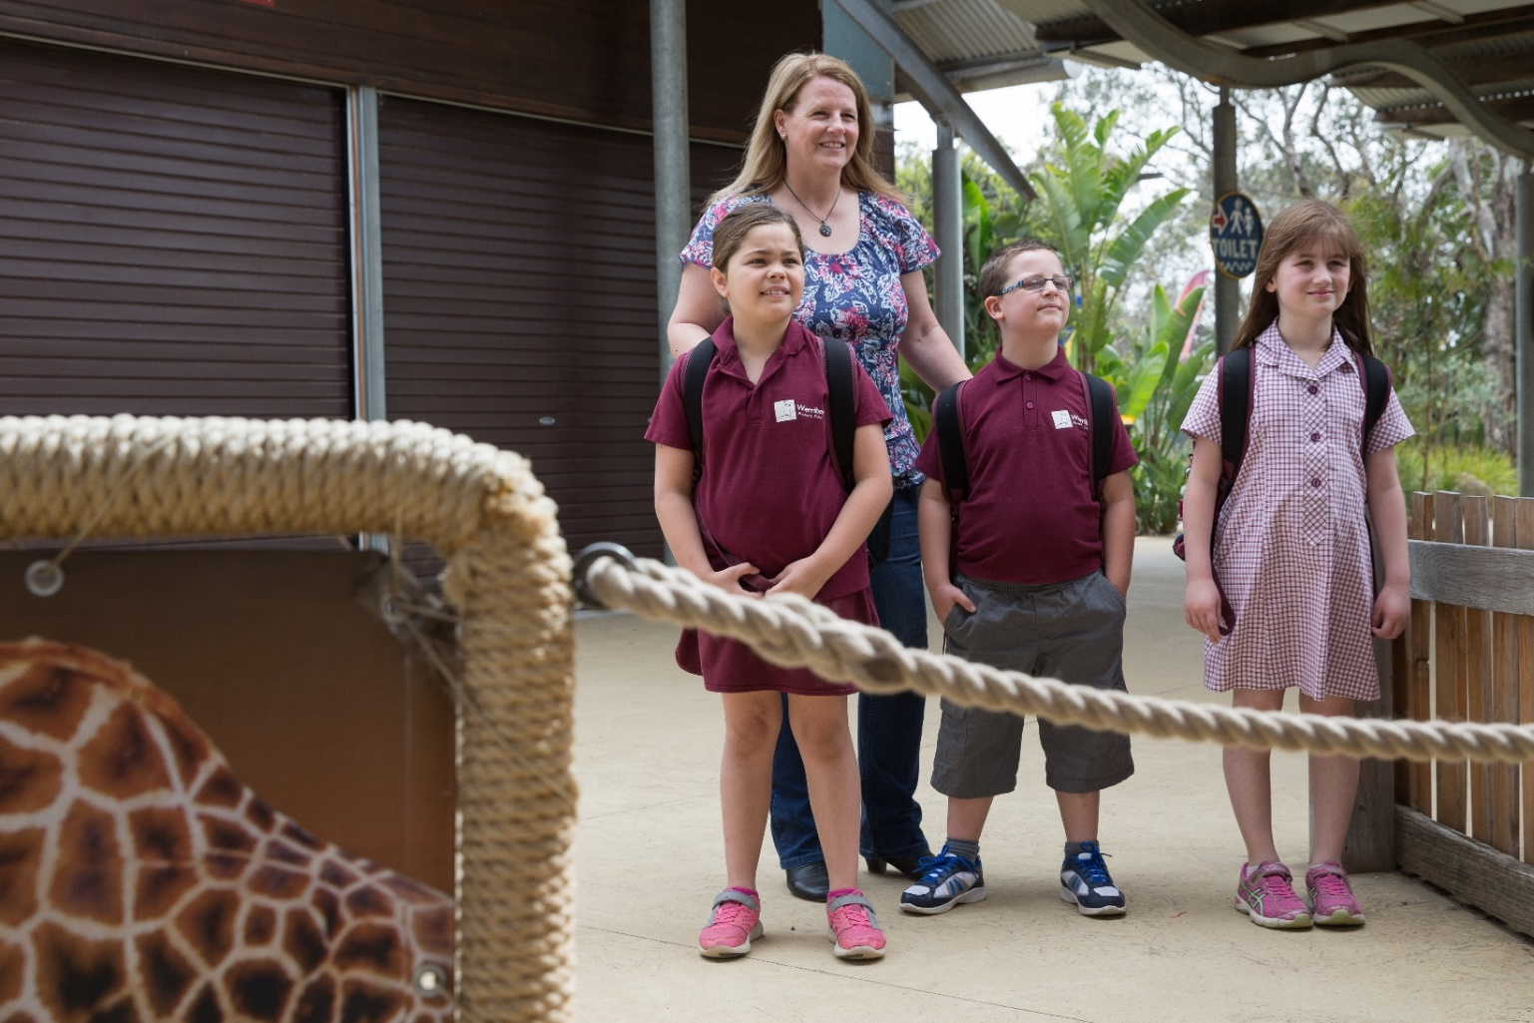
My class is going to Werribee Open Range Zoo. It is a place where I can look at animals, and learn about them and their habitats. There is a safari bus ride to see some very big animals. There will be other visitors at the Zoo that I need to share the space with.

Slide 3
Arriving at the Zoo The bus will drop my class off outside the Zoo, and I will be able to see the entrance.

Slide 4
Arriving at the Zoo
My teacher will go up to the bus window to get the program for the day.
I may have to wait in line with my class and adult helpers before we go in. I can talk to my friends about the animals we will see soon. There may be other schools arriving at the same time, so it is important I stay with my class.

Slide 5
Going into the Zoo
When I go inside the Zoo, I will see this open area. On a busy day, I will see lots of other people.
All the other people are here to see the animals too, but will also be using the toilets, and the playgrounds too.
I will always be with my teacher, if there is anything or anywhere that I don’t like, I just need to tell my teacher.

Slide 6
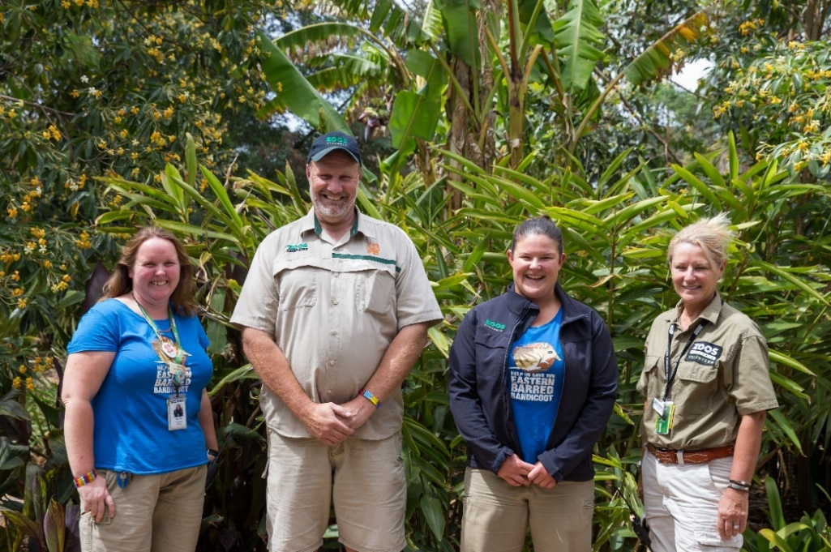
Staff and Volunteers
There are lots of staff and volunteers at the Zoo who are here to help me and
answer my questions.
If I get lost from my group, I can ask them for help.
They may be wearing different clothing, but they will all have one of these logos
on their clothing.
They might have a radio to talk to other people to help me.

Slide 7
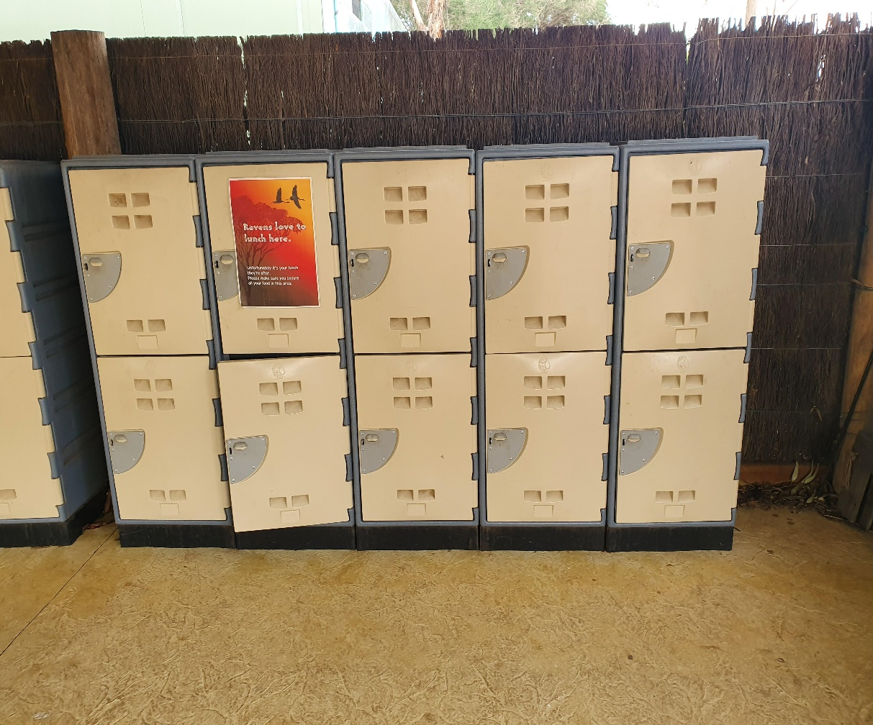
Lockers
I might be asked by my teacher to put my
bag with my lunch into a locker.
I will come back to get my snack and lunch
later if I put my bag away.
My bag will be safe here.

Slide 8
Walking around the zoo I might visit all areas of the zoo or I might visit just a few. My teacher has a map and knows where we are going. It’s important that I listen to my teachers directions and stay with my group.

Slide 9
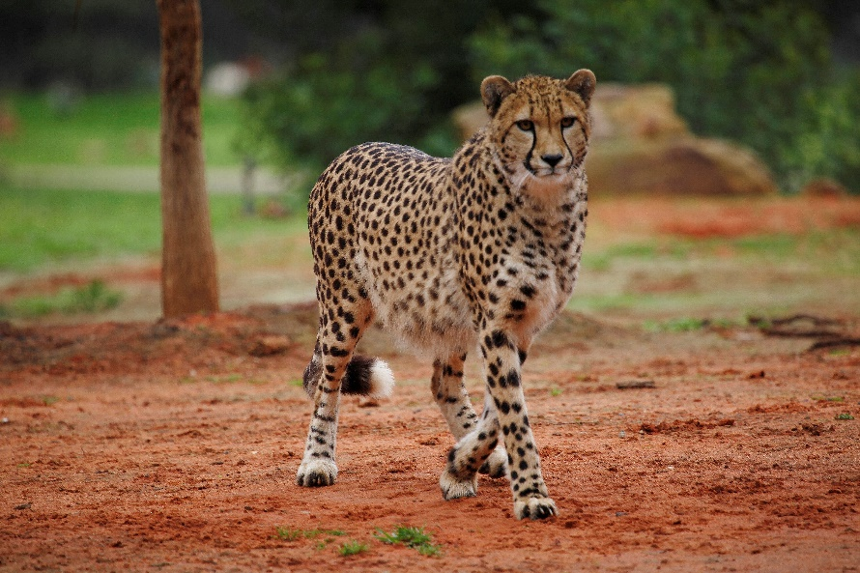
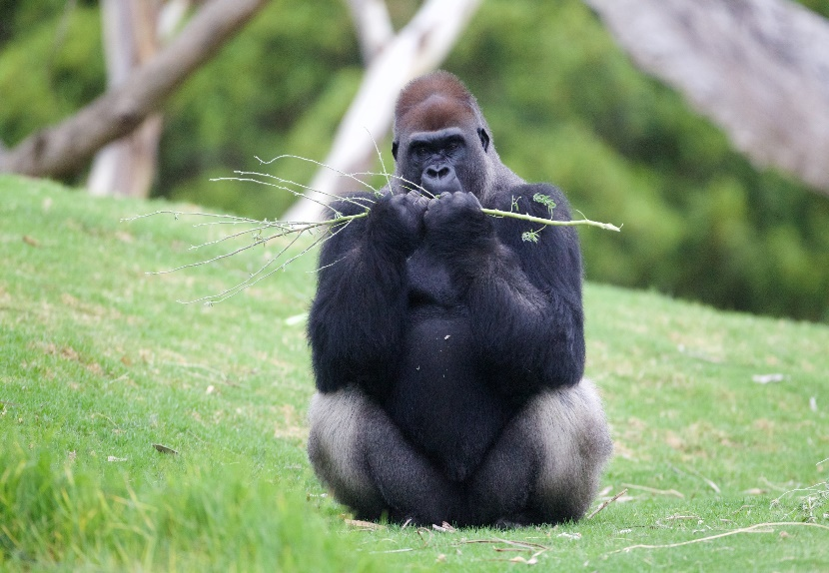
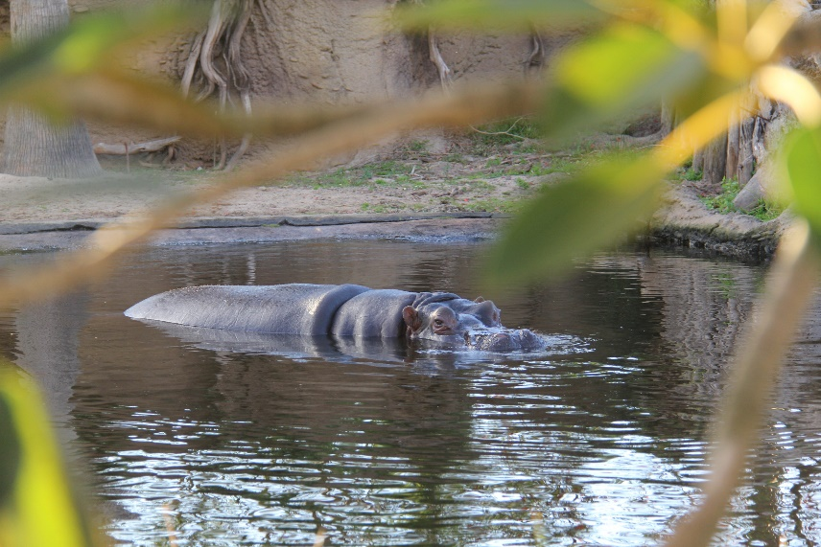
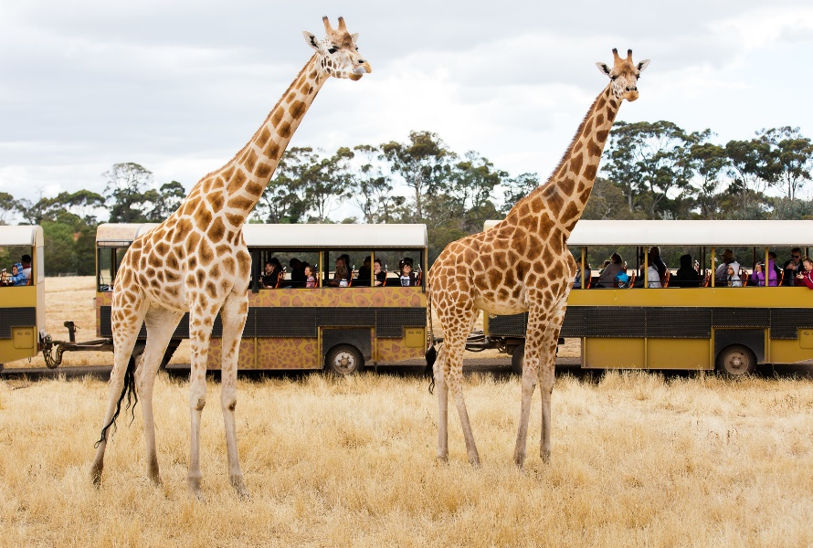
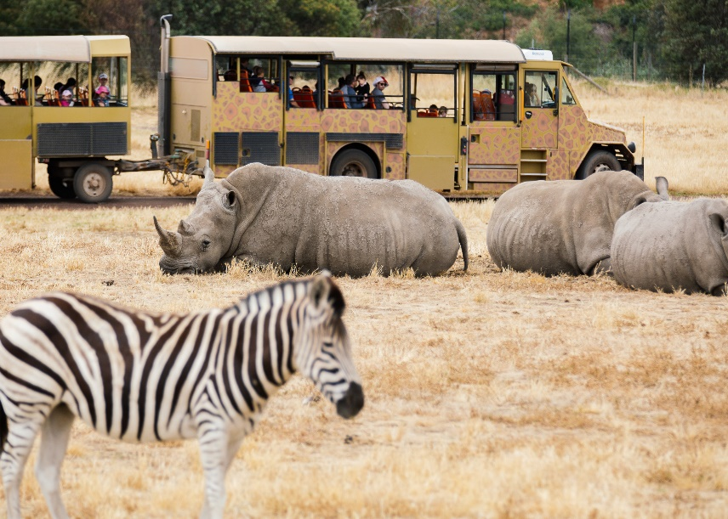
While I'm walking around the trails and on the safari bus I will see lots of different animals

Slide 10
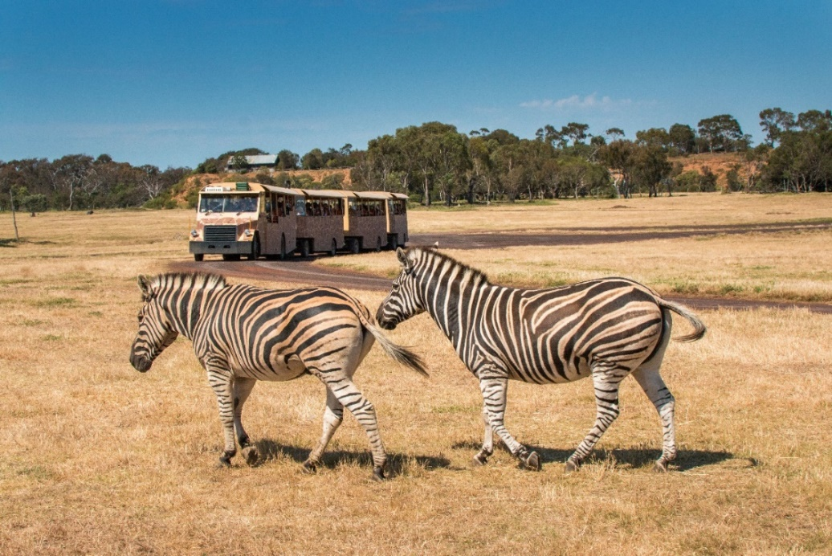
Safari bus I might go on a safari bus with my class. My class may have to line up and wait to get on the bus. I need to walk and not run as I am getting on the bus. We will drive around and see lots of bigger animals. It is important to stay seated when the bus is moving so I don’t fall over. The bus can be very loud and noisy.

Slide 11
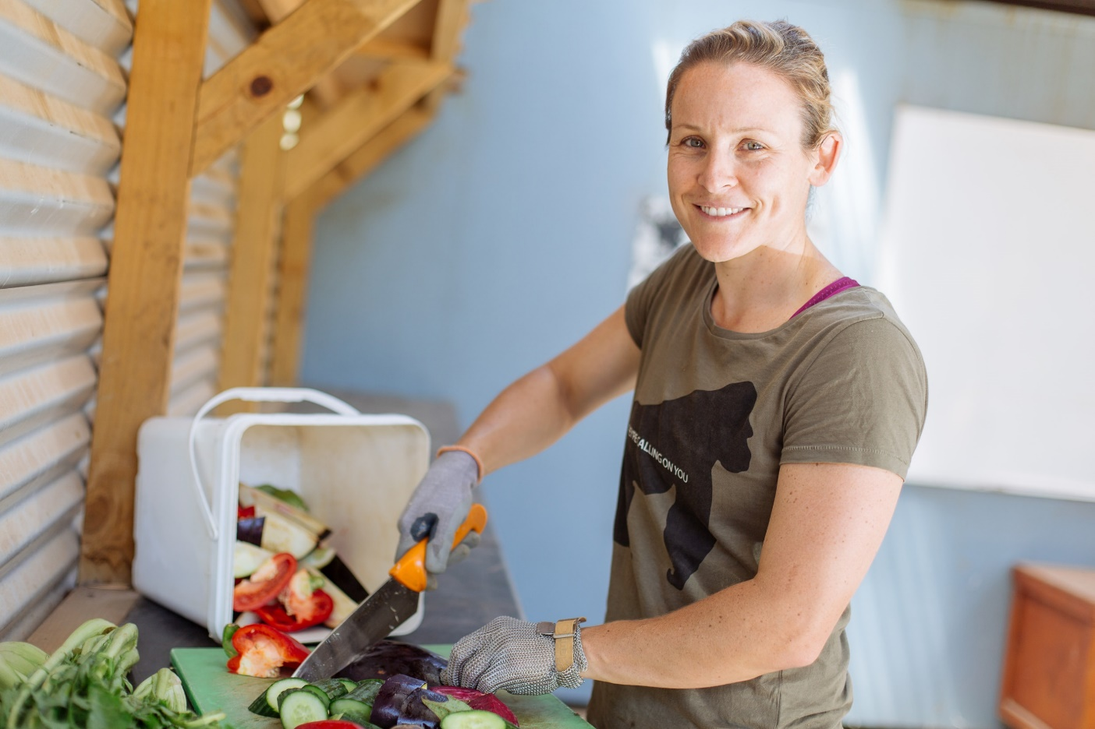
Zoo keepers The animals at the Zoo are very lucky and have special people called zoo keepers who look after them and feed them.
I need to remember not to feed any of the animals or throw any objects into their homes as it might make them sick or injured.

Slide 12
Sound and Smells
There might be unusual smells as you walk around the zoo, as animals smell very different to us.
And they can make interesting, sometimes loud noises too.

Slide 13
Serval presentation I might go with my teacher and my class into the Crazy about Cats keeper talk. I will sit quietly on the chairs and not call out loudly when the cat comes out. The doors will be closed so that the cat can not escape. I will be safe sitting with my class.

Slide 14
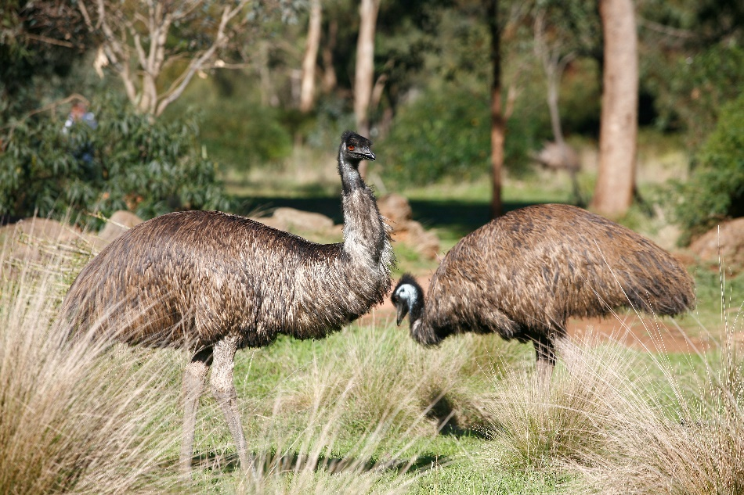
Australian Journey I might go into an area of the Zoo where kangaroos and emus can walk freely around me. I need to stay quiet and walk so that the animals don’t feel scared. I will be safe as well.

Slide 15
Glass windows Some of the animals are behind glass windows. They might get scared if I knock on the glass.

Slide 16
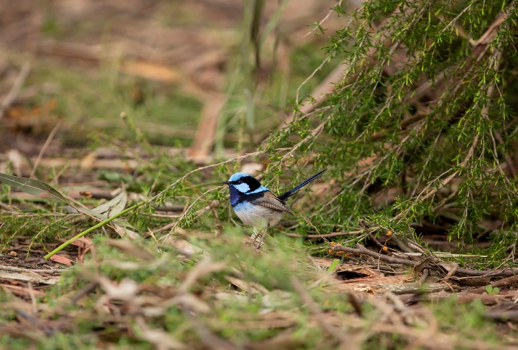
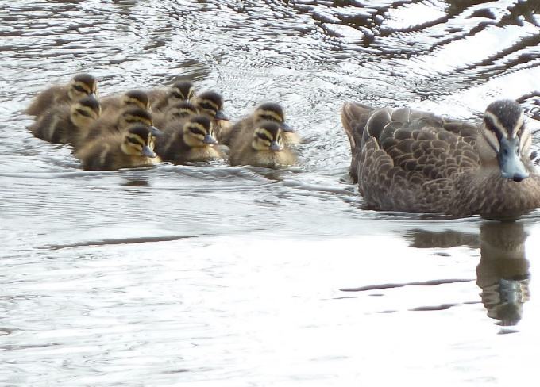
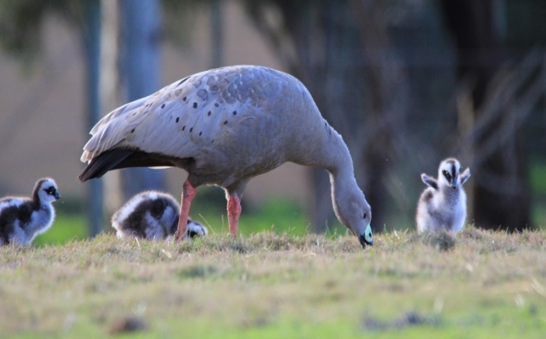
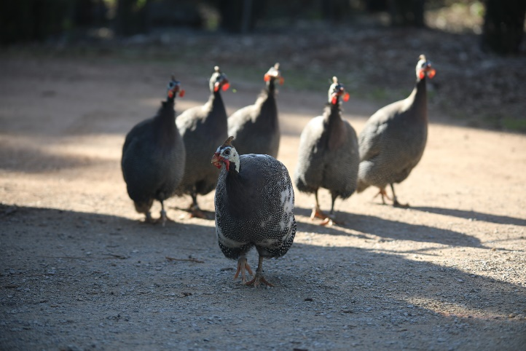
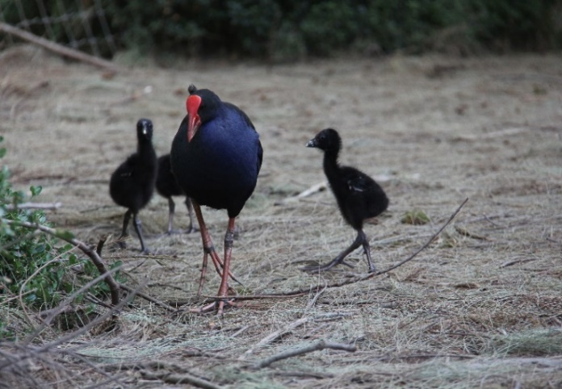
Birds Lots of wild birds live at the Zoo. I might see them walking or flying round. They will not hurt me, and I will be safe if I don’t chase them or feed them.

Slide 17
Eating at the Zoo
I will wait until my teacher tells me it is time to eat.
I do need to remember to wash my hands before eating any of my food.

Slide 18
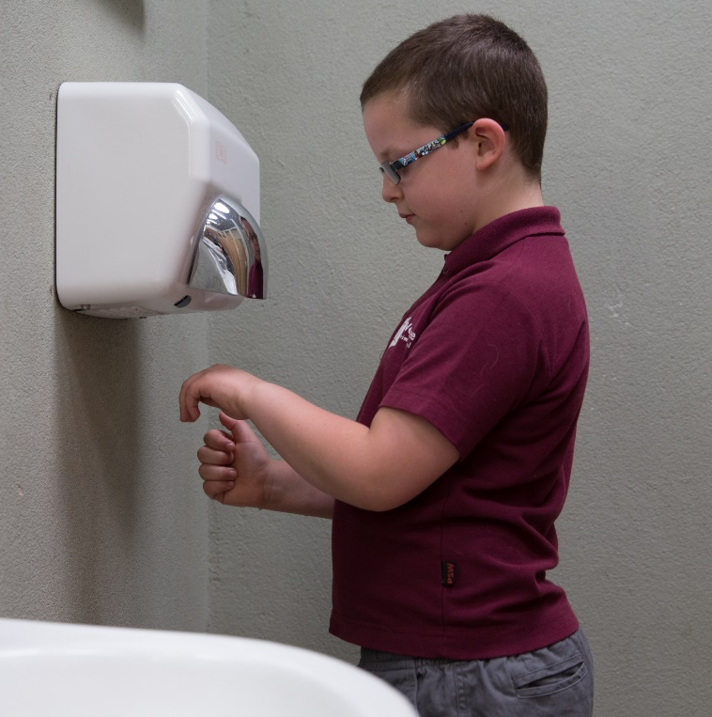
Bathrooms
If I need to go to the bathroom, I will tell my teacher, and they will look on the map to find the closest one.
There may be other people using the bathrooms.
In the bathrooms there are hand dryers, some people use these to dry their hands.
If I press the button it will make a loud noise.

Slide 19
Important things to remember
Follow the adult who is leading the group
Stay close to my group
Walk and not run
Speak with my quiet voice, even though it may be noisy
Wait patiently when I have to line up
Only touch things that I am allowed to
Listen carefully when an adult is talking to you
To be quiet around the animals and not scare them by tapping on the glass
Do not feed or throw any objects into the animals homes

Slide 20
Goodbye
When my teacher tells me it’s time, I must get back on the bus to go back to school.
I can wave goodbye to all the staff and the animals.

Slide 21
I am going to Werribee Open Range Zoo with my class today. Everyone at Werribee Open Range Zoo hopes I have an amazing day.

Slide 22
Workshop for students with special needs in Activ8
I will meet a zoo conservationist at the cheetah and go off the path and behind the scenes for our education workshop.
I will be able to make some animal enrichment toys for an animal and learn what animals, particularly predators need to survive and their features.
So I don’t scare the animals I should remember to be quiet and not knock on the glass.

Slide 23
Kindergarten to Year 2 student workshops
I will meet a zoo conservationist at the Habitat Haven for our education workshop.
I can play with my classmates or by myself at any of the activity stations looking for what animals need to survive, their features and life cycles.
I can explore safely in the Habitat Haven as it has a animal proof fence.

Slide 24
Year 3 to Year 6 student workshops
I will meet a zoo conservationist for our education workshop at a location around the zoo. My teacher will have the location highlighted on our itinerary map.
During the workshop there will be a variety of activities, discussion and time to ask the zoo conservationist some questions.
I might have to walk to the location of our workshop. There will be other visitors on the path so I should stay on the left of the path.

Slide 25
Year 7 to Year 10 student workshops
I will meet a zoo conservationist for our education workshop at a location around the zoo. My teacher will have the location highlighted on our itinerary map.
During the workshop there will be a variety of activities, discussion and time to ask the zoo conservationist some questions.
I might have to walk to the location of our workshop. There will be other visitors on the path so I should stay on the left of the path.

